Slide 1
OUT OF INTERNET
DINOSAUR-GAME >> PARODY <<
PROJECT_C:TEAM 3

Slide 2

MEMBERS OF TEAM 3
Ngo Viet Tien
Van Phu Hoa
Tran Minh Khang
Dang Phuong Anh
Leader
Member
Member
Mentor

Slide 3
TABLE OF CONTENTS
01
02
03
04
INTRODUCTION
NEW FEATURES
LOGIC FUNCTIONS
RUN DEMO

Slide 4
01
INTRODUCTION
How is this game familiar to us ?

Slide 5

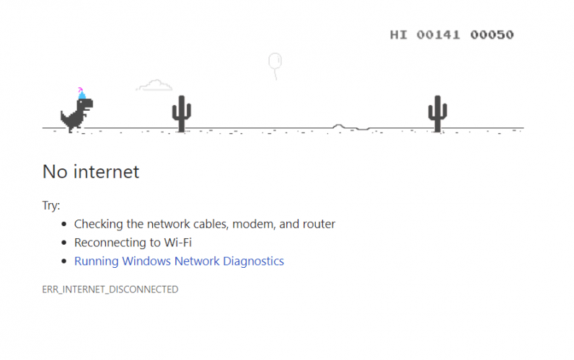
DINOSAUR GAME OF GOOGLE
An extremely familiar game for everybody when losing internet.

Slide 6


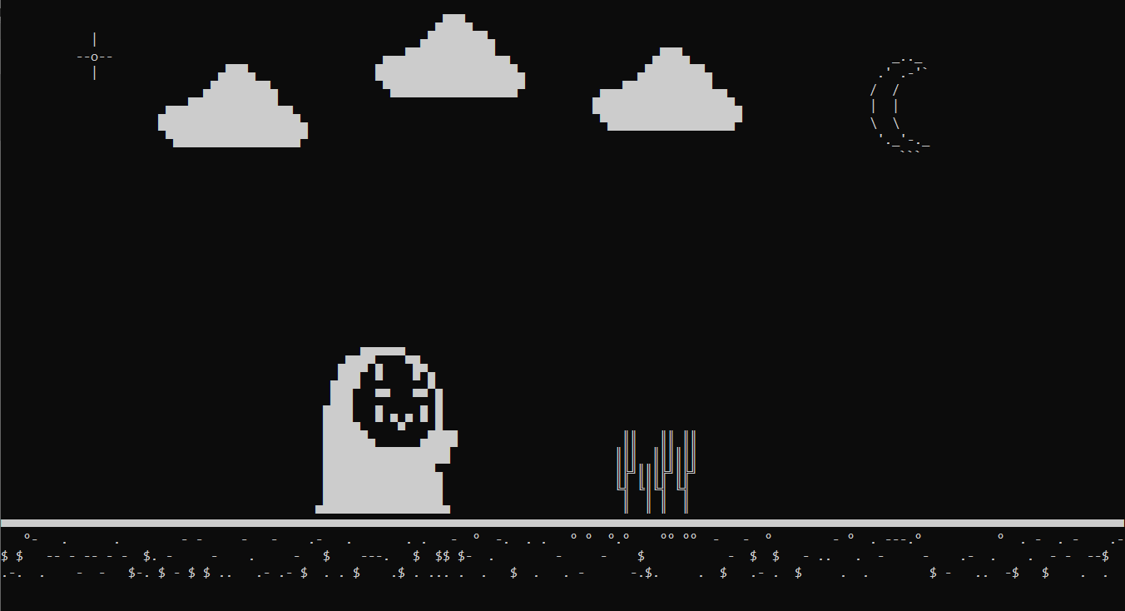
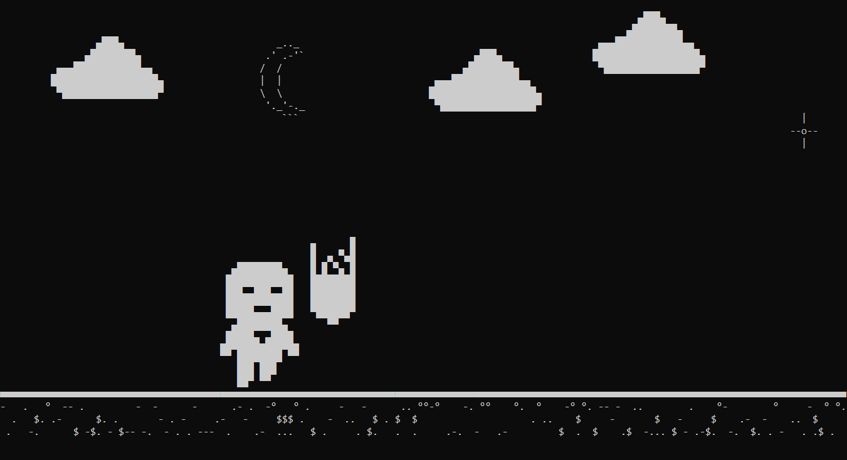

Slide 7
02
FEATURES OF GAME
How is Out Of Internet more wonderful than original version ?

Slide 8
OUR FEATURES
CHARACTERS
OBSTACLE
MOVE
LOGIN SYSTEM
LEVEL OF DIFFICULTY

Slide 9
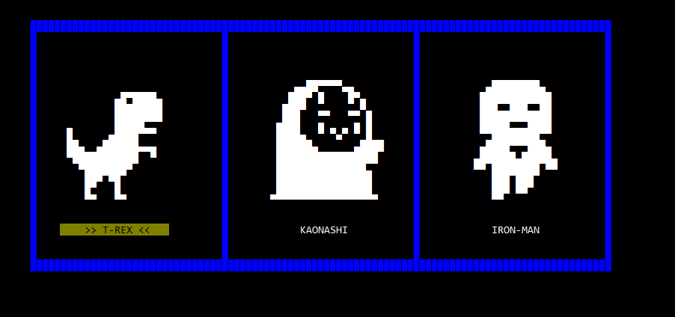
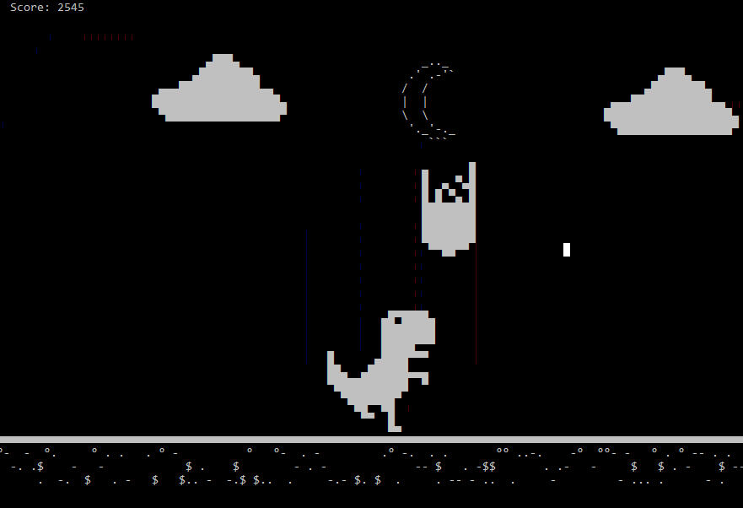
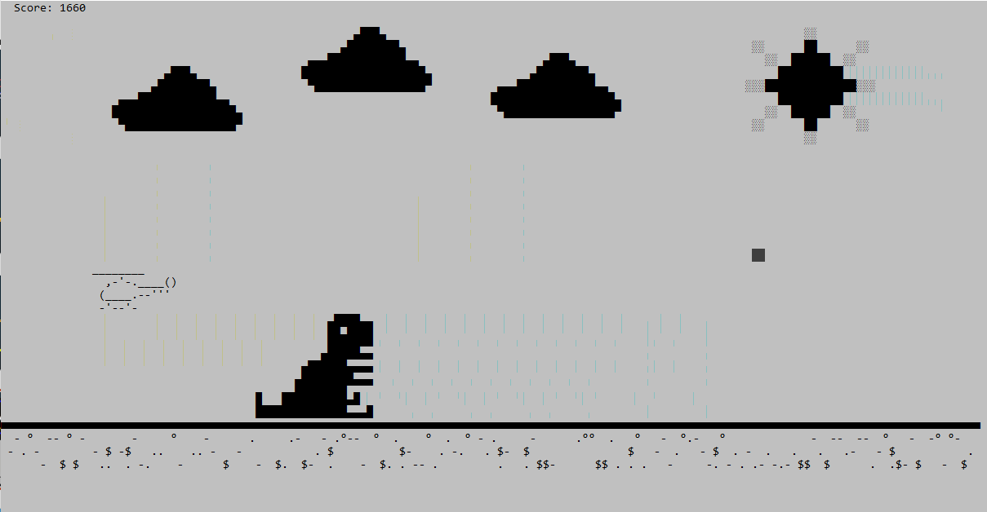

Slide 10
03
LOGIC FUNCTIONS
How to build this game ?

Slide 11
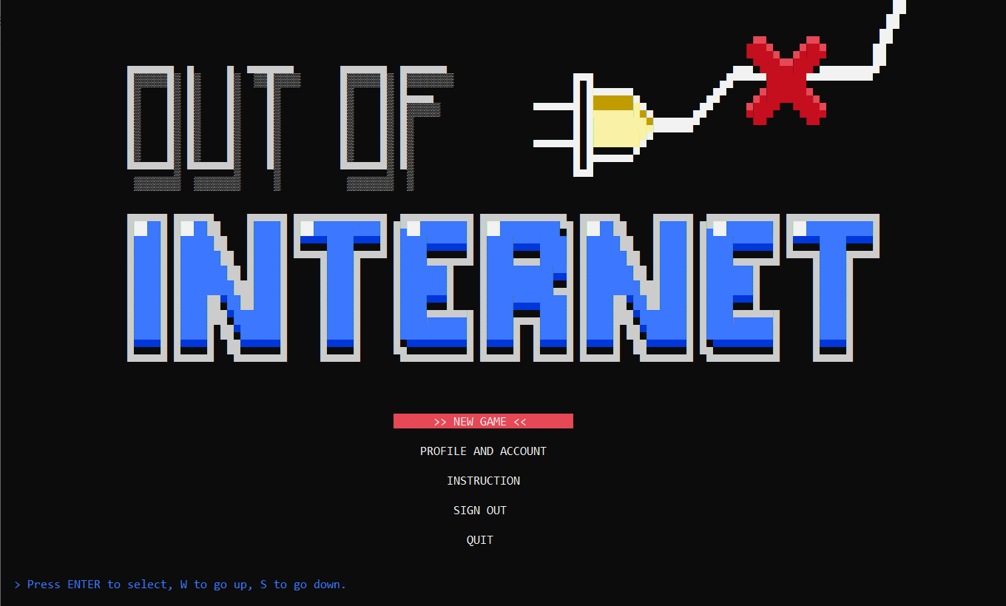
PATTERN DRAWING
How can we design letters in console screen ?

Slide 12

How do we draw the title of the game?

Slide 13
There are 16 colors available in C,
which are numbered 0 to 15
0 = Black
1 = Blue
2 = Green
3 = Aqua
4 = Red
5 = Purple
6 = Yellow
7 = White
8 = Gray
9 = Light Blue
A = Light Green
B = Light Aqua
C = Light Red
D = Light Purple
E = Light Yellow
F = Bright White

Slide 14
220 - Top block
219 - Block
220 – Bottom block

Slide 15
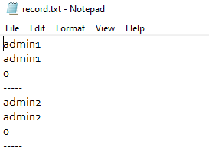
STRING HANDLING

Slide 16

WAY TO DRAW AND MOVE OBJECTS
OUT OF INTERNET

Slide 17
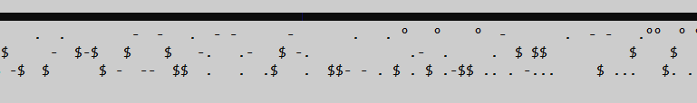
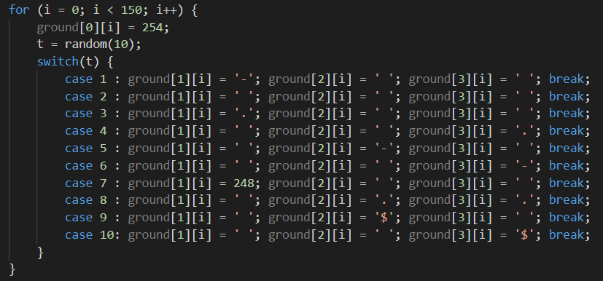
GROUND:
CODE:

Slide 18



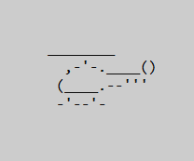
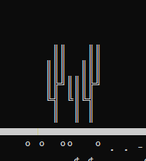


Slide 19
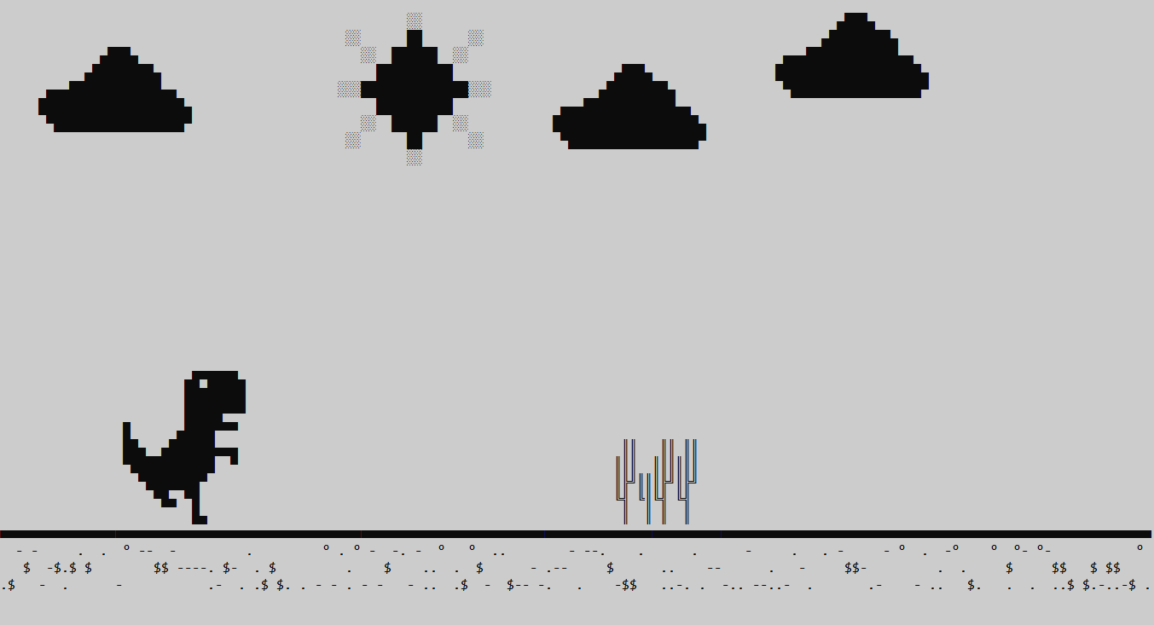

Slide 20
D
MOVE FORWARD
A
MOVE BACKWARD
W
JUMP
S
SIT DOWN
WAY TO DRAW AND MOVE CHARACTERS

Slide 21
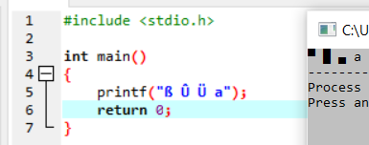
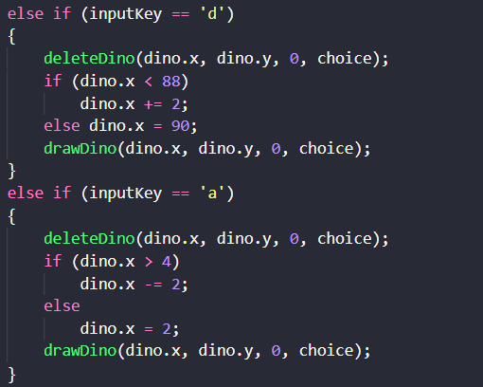
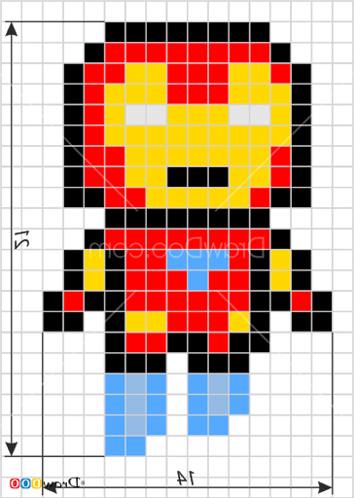
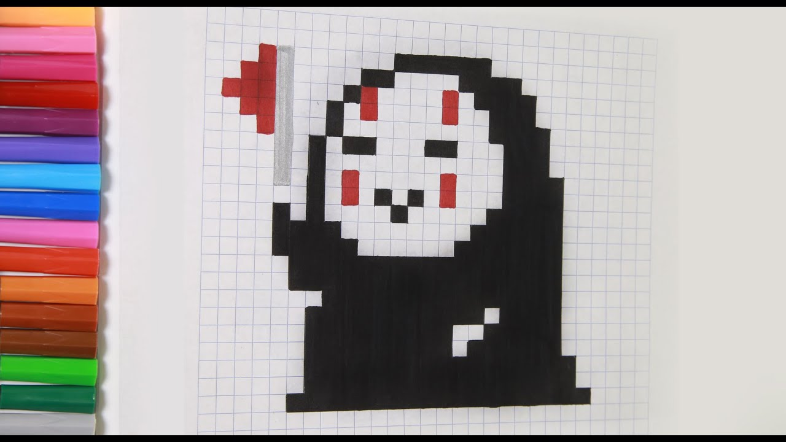
HOW CAN WE DRAW THEM?

Slide 22
CHECK COLLISION
How can we check collision to end game and save score ?

Slide 23
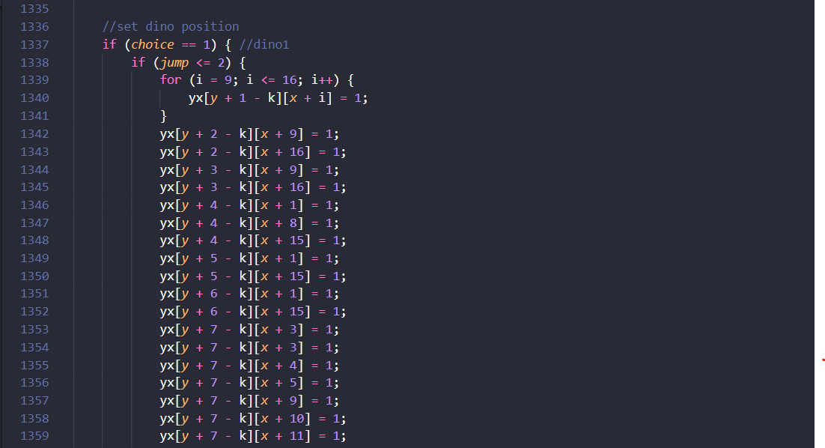
CHECK COLLISION

Slide 24

04
RUN DEMO
Now you can start experience Out Of Internet.

Slide 25

THAHK YOU
From Out Of Internet development team !

